Slide 1

Exploring Wine Characteristics Using Machine Learning Techniques
wine check

Slide 2

YOTAM ELIA
Exploring the Wine Dataset

Slide 3
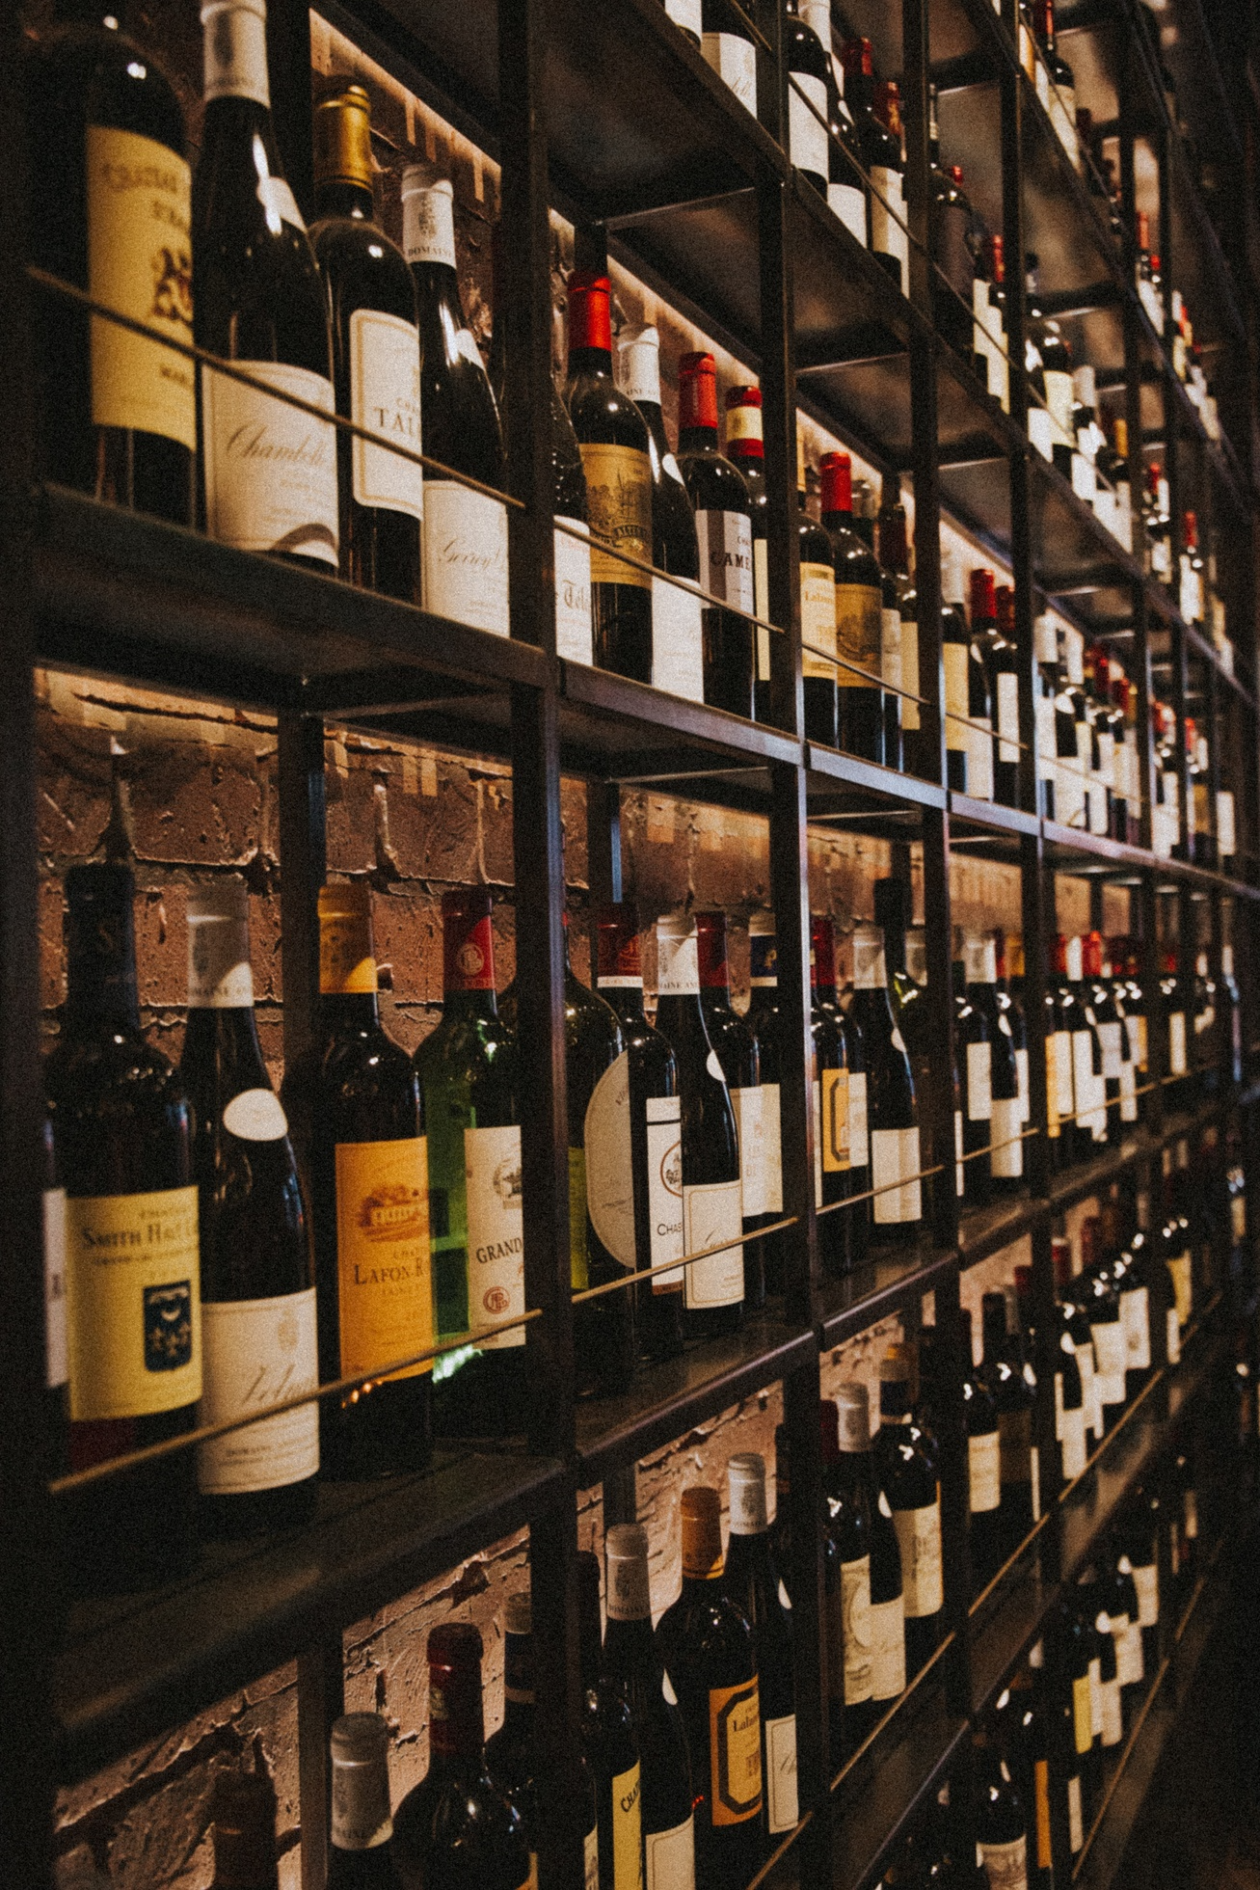



Process Flow
80% of my Success will Come From Chat GPT And Beautiful AI
Exploratory Data Analysis (EDA)
Preprocessing and Feature Engineering
Machine Learning Algorithms
Results and Analysis
Statistical summary of the dataset
Distribution of attributes
Correlation analysis
Handling missing values (if any)
Encoding categorical variables
Feature scaling
Feature selection (if necessary)
Decision TreesRandom
ForestsSupport Vector Machines
(SVM)
k-Nearest Neighbors
(k-NN)Naive
BayesLogistic
Regression
Performance evaluation of machine learning algorithms
Performance evaluation of deep learning
algorithmsComparison of results
Discussion of insights gained
Notes:
Always Be Prioritizing Don't fall victim to "check-list" marketing. That is, don't feel compelled to create a giant list of all the marketing activities you can possibly execute. Hold on to the focus you established with your Big Goal and Growth Plan. Pick the 3 most important aspects of your marketing plan that will drive 80% of your results. Position these as your big levers. You will not be derailed from making them a success.

Slide 4
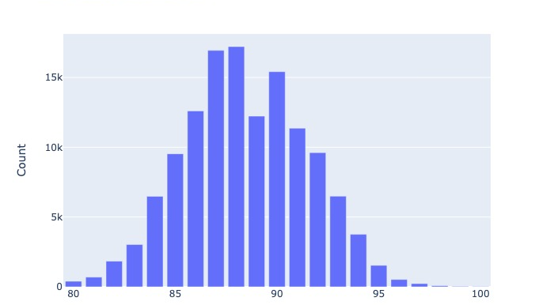
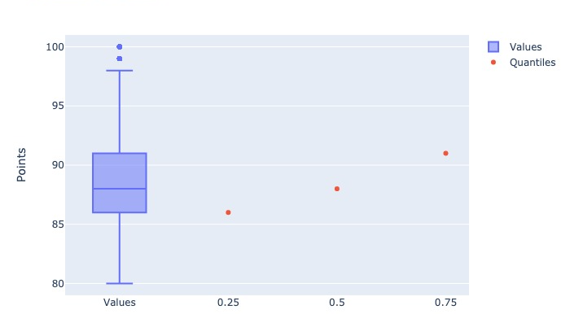
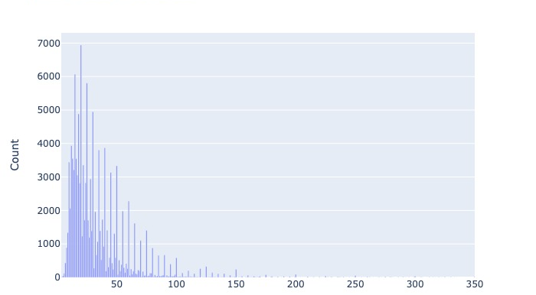
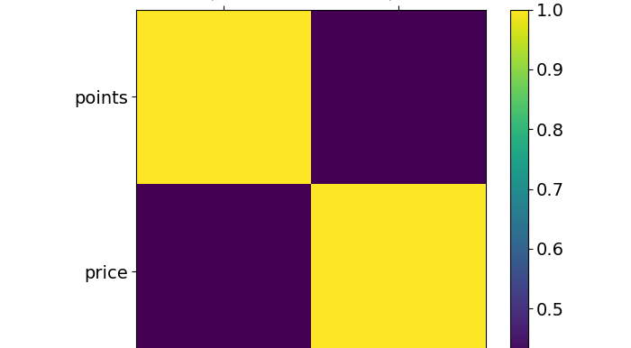

Slide 5
Point Distribution
Gaussion distribution
most point is destribute around 87
we can assume the distribution of the test data should destribute the same way

Slide 6
Quantiles Of Points
We can observe that the points are distributed in a Gaussian pattern.
It can be assumed that the distribution of the predicted data will be the same as the data presented here.
we can see that between the 25% and the 75% the increase of the point is almost linear

Slide 7
Prices Unique Information
It is close to the gaussian but not enough.
Skewness being positive means that the distribution has a tail extending to the right.
One can see that a small tail in a distribution may indicate a lower kurtosis, or possibly even a negative kurtosis.

Slide 8
Correlation Matrix
we ca see that the correlation between Points and Price is not high
we can assume that people new about the price before giving review
mean maybe high price make people expect the wine more then a cheap wine

Slide 9
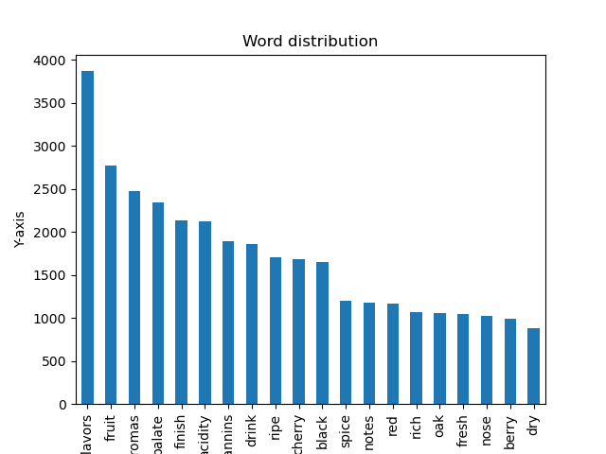
Pure Text Description
Description Clean Distribution
The data in the description dataset indicates that the majority of words have fewer than 500 occurrences, suggesting a correlation between the points given and these words may be more reliable as hypothesized.
Most common words
The most frequently occurring word in this dataset after cleaning is "Iavors".
We can assume that the most frequent word is not related to the points given in the reviews, as it is likely to be present in all reviews.
Don’t use a bullet template for every slide.
When every slide looks the same, your presentation gets monotonous and boring. Use bullet slides thoughtfully and sparingly.

Slide 10
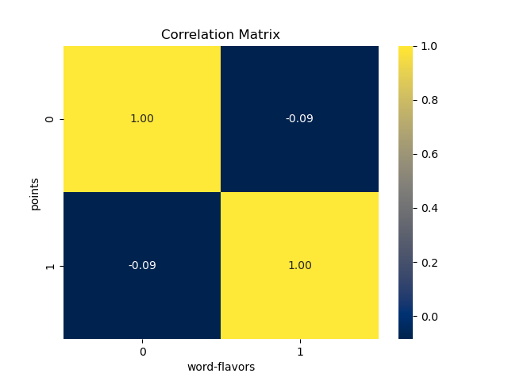
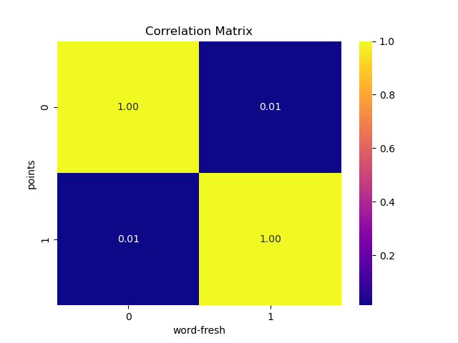

Flavors Vs Fresh

Slide 11
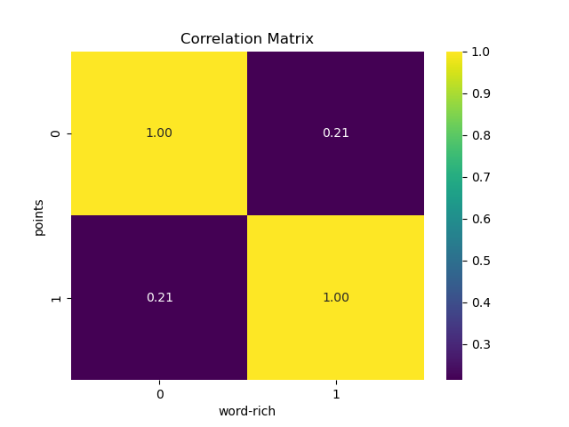
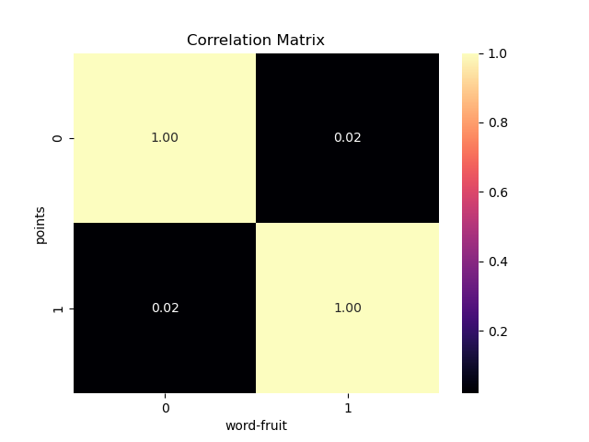
Rich Vs Fruit

Slide 12
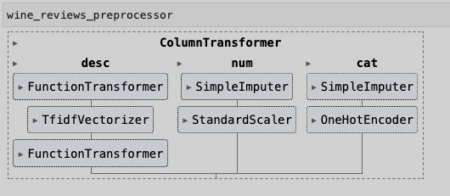










Machine Learning Algorithm
1
Linear Regression
2
Lasso
3
Ridge
4
DecisionTreeRegressor
5
RandomForestRegressor

